Slide 1
GCP Foundation
MODULE 1 :
INTRODUCTION To GCP

Slide 2
Revision History
Version | Date | Author | Reviewed by | Comments
1.0 | 03-March-2025 | preetham.gowda |  | Initial Version

Slide 3
Explain the concept of Cloud, IAAS, PaaS, and SAAS
Describe Google Cloud Platform foundations
Create account on GCP
Explore Cloud Console
Use Cloud Shell

Slide 4
Module Agenda
1
Cloud Concepts
i
IAAS, PAAS, SAAS
2
GCP Fundamentals
i
Services on GCP
ii
GCP Account
iii
Cloud Console
iv
Cloud Shell

Slide 5

CLOUD CONCEPTS

Slide 6
What is Cloud Computing?
Collection of computational resources like compute, storage & database
It provides on-demand access to all these resources
Through the internet
With an option of pay-as-you-go pricing model
Notes:
https://en.wikipedia.org/wiki/Cloud_computing
Link to GCP document
https://cloud.google.com/what-is-cloud-computing
Collection of computational resources like compute, storage & database

Slide 7
Cloud Deployment Models
Public Cloud
Resources delivered through the public Internet
Private Cloud
Infrastructure operated solely for a single organization
Managed internally or by a third party
Hosted either internally or externally
Hybrid Cloud
Combination of public and private cloud

Slide 8
Cloud Service Models
3 Standard Models
Infrastructure As A Service (IaaS)
Platform As A Service (PaaS)
Software As A Service (SaaS)
Many other variations
Backend as a service
Function as a service
Serverless Computing
IAAS | PAAS | SAAS
Application | Application | Application
Data | Data | Data
Runtime | Runtime | Runtime
Middleware | Middleware | Middleware
O/S | O/S | O/S
Virtualization | Virtualization | Virtualization
Servers | Servers | Servers
Storage | Storage | Storage
Networking | Networking | Networking

Slide 9
GCP FUNDAMENTALS

Slide 10
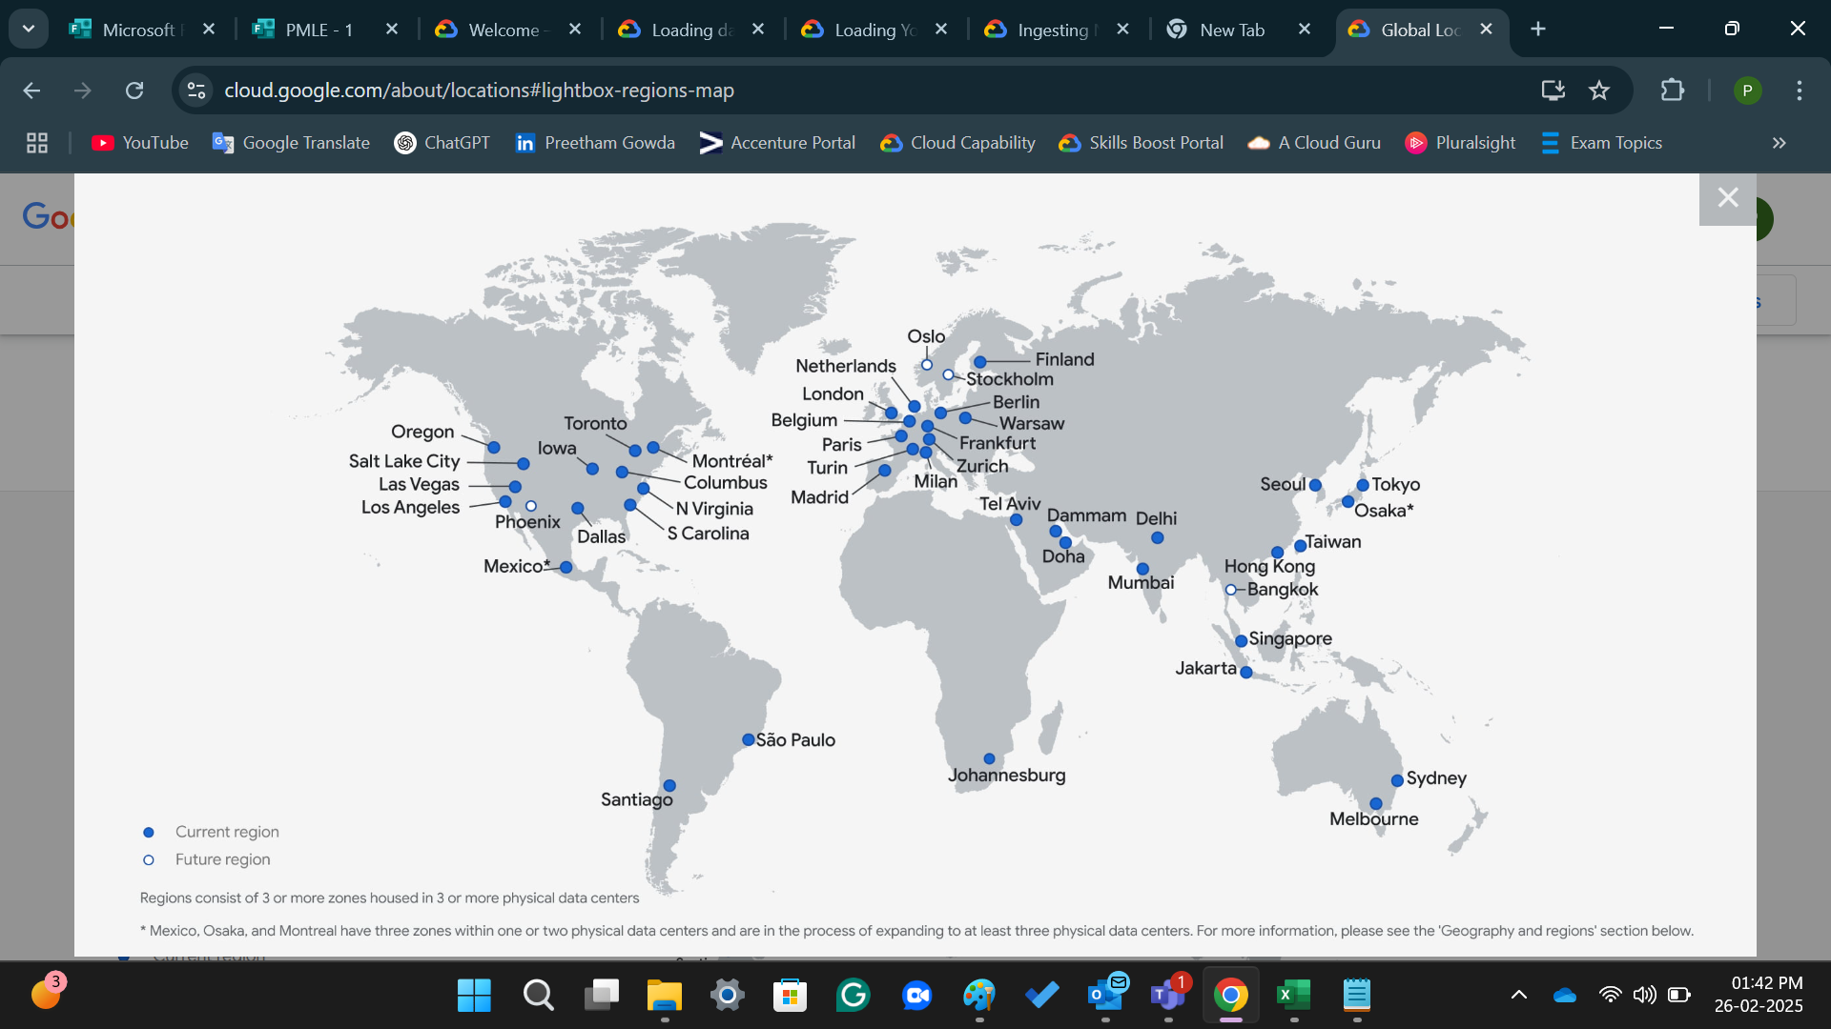
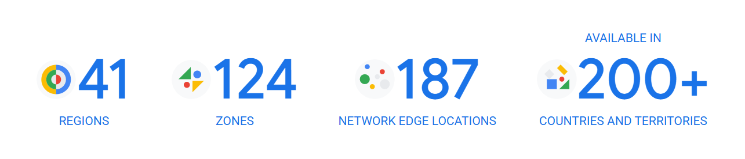
Google Cloud Overview
Resources
Google Cloud represents
Set of physical assets (computers and hard disk drives)
Virtual resources (virtual machines (VMs)
Contained in Google's data centers around the globe
Data center is in a region
Region is a collection of isolated zones
Example: zone a in the East Asia region is named asia-east1-a
Notes:
Explain by drawing diagram
Regions are available in Asia, Australia, Europe, North America, and South America. Each region is a collection of zones, which are isolated from each other within the region. Each zone is identified by a name that combines a letter identifier with the name of the region. For example, zone a in the East Asia region is named asia-east1-a.
Location:US, Asia, Australia, Europe
US[Regions->us-east1,us-east2,us-west1..etc.,]
Regions[Zones- us-east1 a, us-south-1, us-west1]
Zones[DataCenter->DC1,DC2,DC3,DC4]
Under regions will create multiple zones, will connect with nearest zones for data retrieval which will make less cost compared to data retrieval from farthest zone which will incur more cost
Zones will be named as zone us-east1 a
We can decide where we want to deploy the resources which will be available across.
DataCenters are big building where will have all the resources. Multiple buildings forms data centers & Multiple data centers forms Zones.
Data Center contains set of physical assets, such as computers and hard disk drives, and virtual resources, such as virtual machines (VMs).
Now it has 37 R,112 Zones, 187 N/W Edge locations, 200+
Google Cloud will continue expanding into the following regions: Doha (Qatar), Berlin (Germany), Dammam (Kingdom of Saudi Arabia), Querétaro (Mexico), Malaysia, Thailand, New Zealand, Greece, Norway, South Africa, Austria and Sweden.

Slide 11
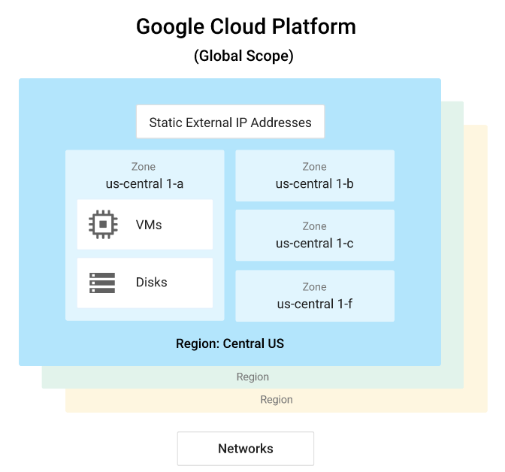
Cloud Resources
Global, Regional & Zonal
Accessing resources through services:
Software and hardware products, become services
Services provide access to the underlying resources
Global resources
Accessible by any other resource, across regions and zones
E.g.: Network
Regional resources
Accessible only by resources that are in the same region
E.g.: Static IP Address
Zonal resources
Accessible only by resources that are in the same zone
E.g.: VMs

Slide 12
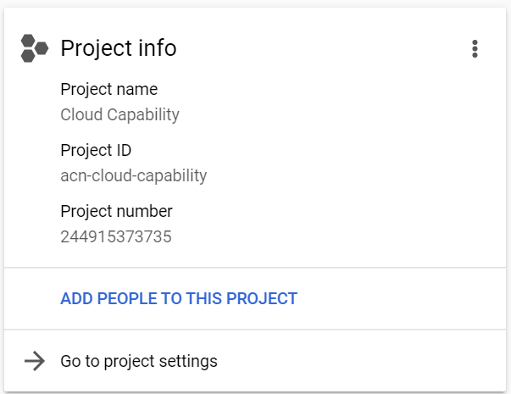
GCP Projects
Organizing entity for your resources
Every resource you create belongs to a project
Resources from one project can work together easily
Project cannot access resources from another project unless you have setup shared VPC
Each Google Cloud project has the following:
A project name, which you provide.
A project ID, which you can provide, or Google Cloud can provide for you.
A project number, which Google Cloud provides

Slide 13
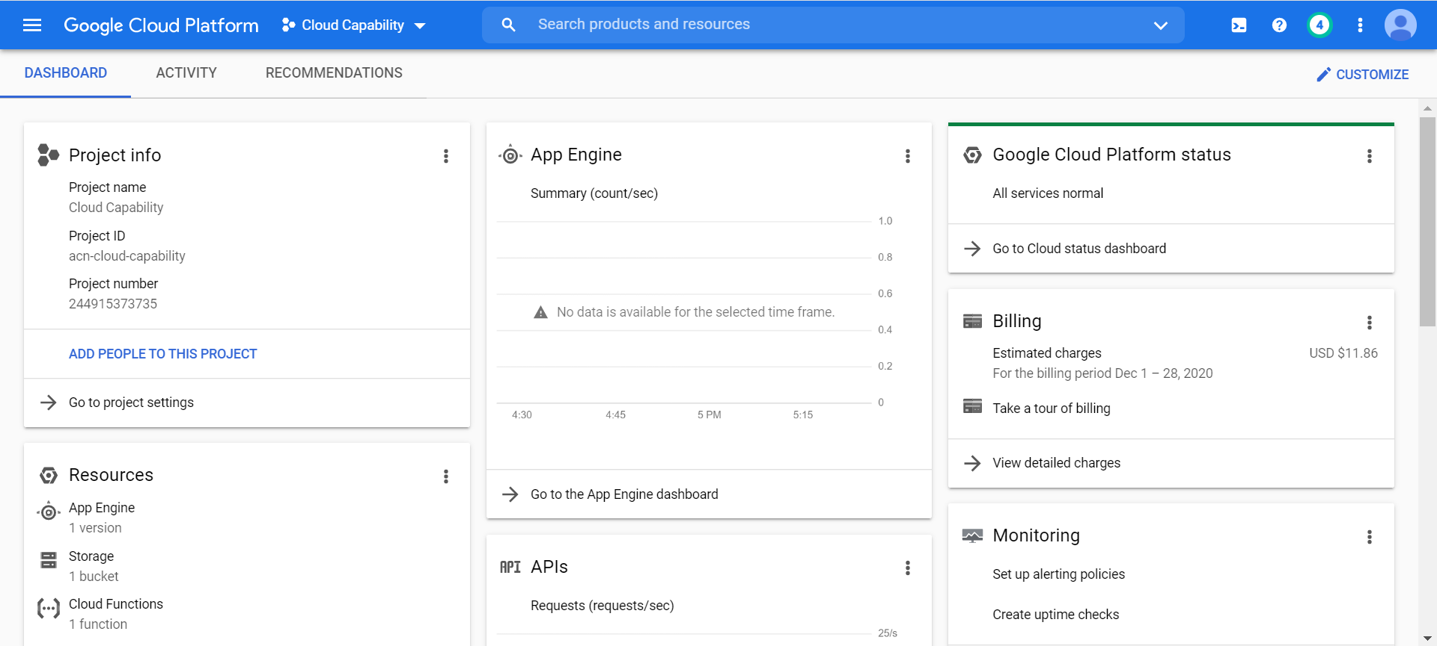
Interacting With Services
Google Cloud Console
https://console.cloud.google.com/
Web-based, GUI

Slide 14
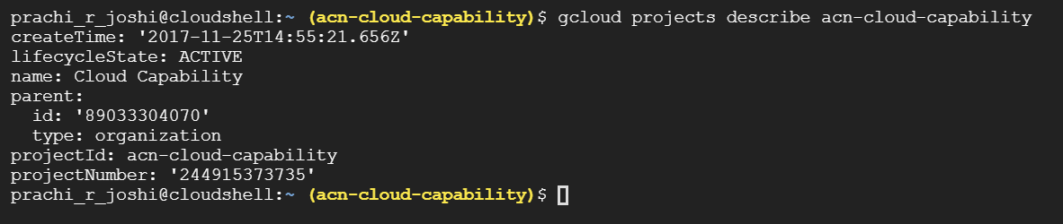
Interacting With Services
Command Line Interface
You can perform most Google Cloud tasks by using the gcloud command-line tool
The gcloud tool lets you manage development workflow and Google Cloud resources in a terminal window

Slide 15
Interacting With Services
Client Libraries
The Cloud SDK includes client libraries that enable you to easily create and manage resources
Google Cloud client libraries expose APIs for two main purposes:
App APIs provide access to services
App APIs are optimized for supported languages, such as Node.js and Python
Admin APIs offer functionality for resource management
For example, you can use admin APIs if you want to build your own automated tools.

Slide 16
GCP Services & Products
Categorized under
Big Query
Cloud CDN
Cloud Functions
Cloud Run
Cloud SDK
Cloud SQL
Cloud Storage
Compute Engine
Kubernetes Engine
Anthos
Operations
Pub/Sub
APIGEE
AutoML
Firestore
IOT Core
Computing and hosting
Storage
Data & Analytics
Networking
Big data
AI & Machine learning
API Management
Developer tools
Anthos & Management
Migration
Security & Identity

Slide 17
Explain the concept of Cloud, IAAS, PaaS, and SAAS
Describe Google Cloud Platform foundations
Create account on GCP
Explore Cloud Console
Use Cloud Shell

Slide 18
THANK YOU

